Slide 1

EMBEDDED SYSTEM DESIGN PROJECT ESE-4009 PCB Designing
Submitted by: HARMANDEEP SINGH (C0751299)
(Group 2)

Slide 2
List of Content
Project Introduction
Task Introduction
Hardware Discussion
Software Discussion
Results
Conclusion
References

Slide 3
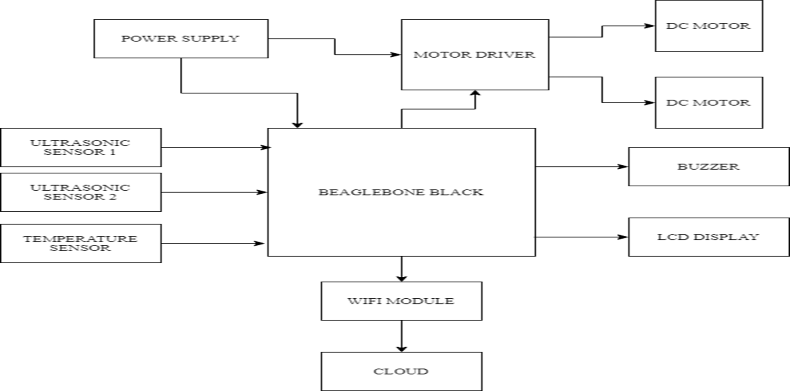
IoT based Visitor Counter using Beaglebone Black

Slide 4
Task Introduction
In the previous meetings we demonstrated the interfacings of all the sensors and modules used in this project.
This Task is about generating PCB design for our project.
We will design and generate all the required files for PCB design.
This task is related to the Schematic capture task which was already discussed previously so we will be using the Schematic prepared in that task to accomplish this task.
In the following slides we shall discuss the composition of a printed circuit board, cover some terminology, a look at methods of basic assembly and discuss briefly the design process behind creating a new PCB.

Slide 5
What is PCB Design
One of the key concept in electronics is the Printed Circuit Board.
Printed Circuit Boards (PCB) design brings your electronic circuits to life in the physical form.
It mechanically supports and electrically connects electrical or electronic components using conductive tracks, pads and other features etched from one or more sheet layers of copper laminated onto and between sheet layers of a non conductive substrate.
It is a board that has lines and pads that connect various points together.

Slide 6
What is PCB Design
A PCB allows power and signals to be routed between physical devices.
Solder is the metal that makes the electrical connections between the surface of the PCB and the electronic components.
Being metal, solder also serves as a strong mechanical adhesive.
The benefit of designing a circuit board for printing is that it is cleaner and more reliable than a circuit built on a breadboard.
We can find PCB today in almost any consumer electronics like Telephone, TV Remote, Alarm clocks, cell phones and many more.

Slide 7
Terminology
Annular ring - the ring of copper around a plated through hole in a PCB.
DRC - design rule check. A software check of your design to make sure the design does not contain errors such as traces that incorrectly touch, traces too skinny, or drill holes that are too small.
Pad - a portion of exposed metal on the surface of a board to which a component is soldered.
Plane - a continuous block of copper on a circuit board, define by borders rather than by a path.
Package – a package is the 3-Dimensional shape of the component, and indicates how it mount to the circuit board.
Footprint – a footprint is the 2-Dimensional layout of the package on the top of the surface of board. It consists of a silkscreen layout, name label, plated through hole or pads, and any other necessary layout information. This is one of the important term and is very important when making a PCB

Slide 8
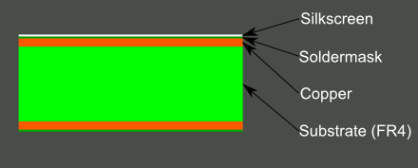
Basic PCB Composition
A PCB is composed of alternating layers of different materials which are laminated together with heat and adhesive such that the result is a single object.
Most of the PCB’s are four layers in which two inner layers are sandwiched between top and the bottom layer.
These layers are :
The base material or Substrate
Copper
Soldermask
Silkscreen

Slide 9
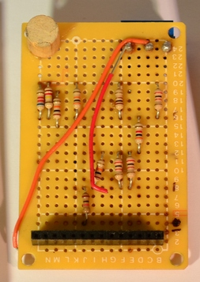
Substrate
The base material, or substrate, is usually fiberglass.
The most common designator for this fiberglass is "FR4".
FR4 is a NEMA grade designation for glass-reinforced epoxy laminate material.
This solid core gives the PCB its rigidity and thickness.
Cheaper PCBs will be made with other materials such as epoxies or phenolics which lack the durability of FR4 but are much less expensive.

Slide 10
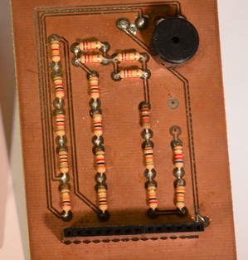
Copper
The next layer is a thin copper foil, which is laminated to the board with heat and adhesive.
On common, double sided PCBs, copper is applied to both sides of the substrate.
In lower cost electronic gadgets the PCB may have copper on only one side.
The image shows PCB with copper exposed with no soldermask or silkscreen.

Slide 11
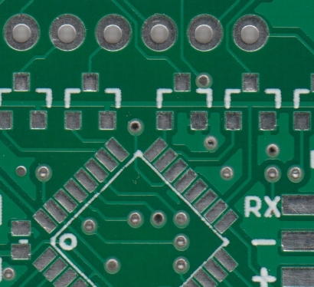
Soldermask
The layer on top of the copper foil is called the soldermask layer.
This layer gives the PCB its green or, red color. It is overlaid onto the copper layer to insulate the copper traces from accidental contact with other metal, solder, or conductive bits.
This layer helps the user to solder to the correct places and prevent solder jumpers.
Soldermask is most commonly green in color but other colors may also be used.

Slide 12
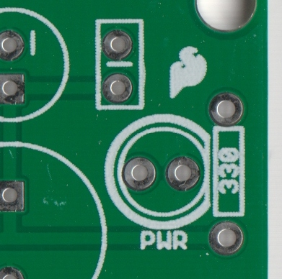
Silkscreen
The white silkscreen layer is applied on top of the soldermask layer.
The silkscreen adds letters, numbers, and symbols to the PCB that allow for easier assembly and indicators for humans to better understand the board.
We often use silkscreen labels to indicate what the function of each pin or LED.
Silkscreen is most commonly white but any ink color can be used.

Slide 13
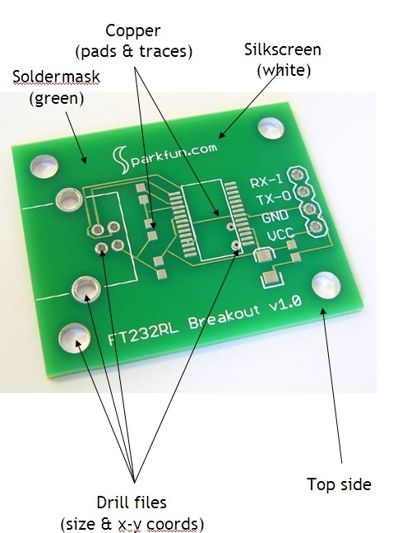
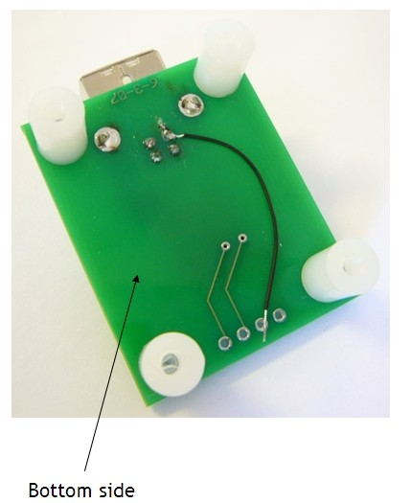
PCB Design summary

Slide 14
Classification of PCB
According to circuit layer classification we have following types of PCB:
Single Sided PCB
Double Sided PCB
Multi layer PCB

Slide 15
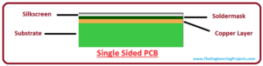
Single Sided PCB
It’s the most basic type of PCB which contains only one layer of base material (Substrate).
They are easy to manufacture in which circuits and components are soldered on one side of the substrate.
Single sided PCBs are an ideal choice for the beginners and are mostly used in simple electronics which don't involve complex circuitry.

Slide 16
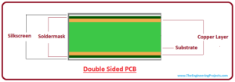
Double Sided PCB
It is similar to single sided PCB with one exception, it contain copper material on the both side of the substrate material.
Double sided PCBs feature moderate level of complexity and mostly used in wide range of applications including automotive dashboard, LED lighting, vending machines, amplifiers, HVAC system, instrumentation and many more.

Slide 17
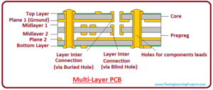
Multi Layer PCB
It is more complex than double sided PCB and come with a combination of single sided and double sided boards.
There are more layers available on these boards than double sided boards.
Multilayers on the boards allow the professionals to make complex and thick designs which help in accomplishing more complex electrical tasks.
Multilayer PCBs are widely used in number of applications including Satellite system, GPS technology, Data storage, File servers and Weather analysis systems.

Slide 18
PCB Designing in EasyEda
EasyEDA is a web-based EDA tool suite that enables hardware engineers to design, share and discuss schematics, simulations and printed circuit boards.
Other features include the creation of a Bill of Materials, Gerber and pick and place files and documentary outputs in PDF, PNG and SVG formats.
EasyEDA allows the creation and editing of schematic diagrams, and the creation and editing of printed circuit board layouts and, optionally, the manufacture of printed circuit boards.

Slide 19
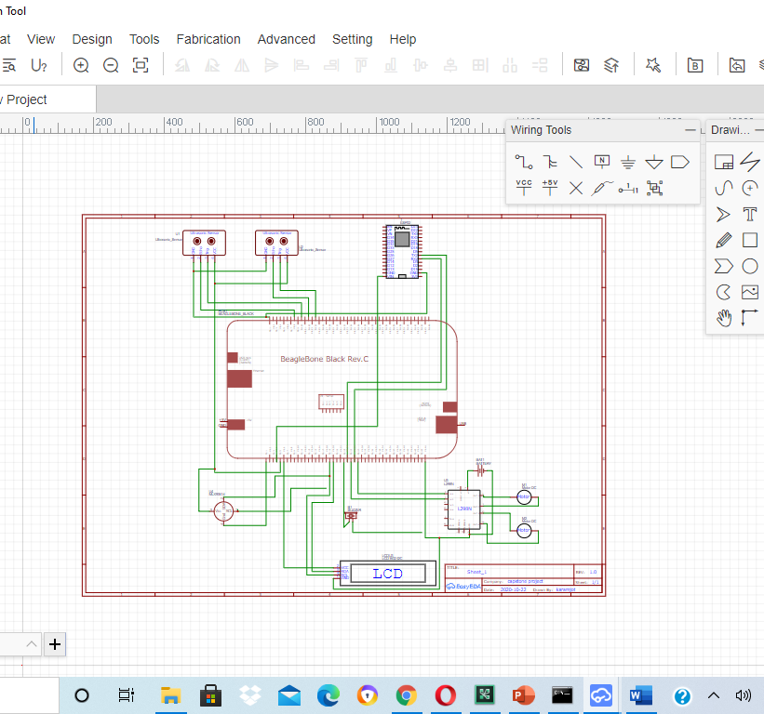
PCB Design Steps
The first step is to create a schematic, since we have already covered this task before so we will use the same schematic.
After preparing the schematic then click on convert to PCB option.

Slide 20
PCB Design Steps
Once our schematic was ready we were ready to generate the PCB design for our project.
When we tried to convert the schematic to PCB we faced some issues because some of the components which we used did not have a footprint thus we couldn’t generate the PCB.
Thus after some changes in the schematic we were able to generate the PCB design successfully.
The updated schematic and the footprint error can be seen in the following slides.

Slide 21
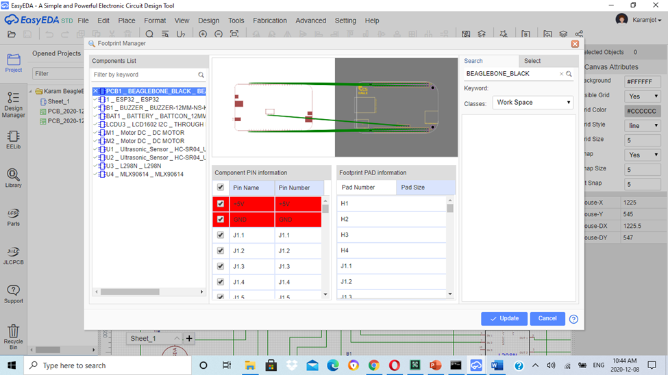
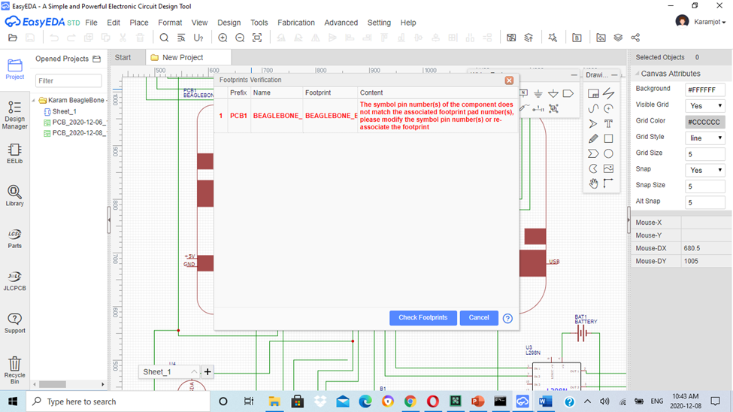
Footprint Errors

Slide 22
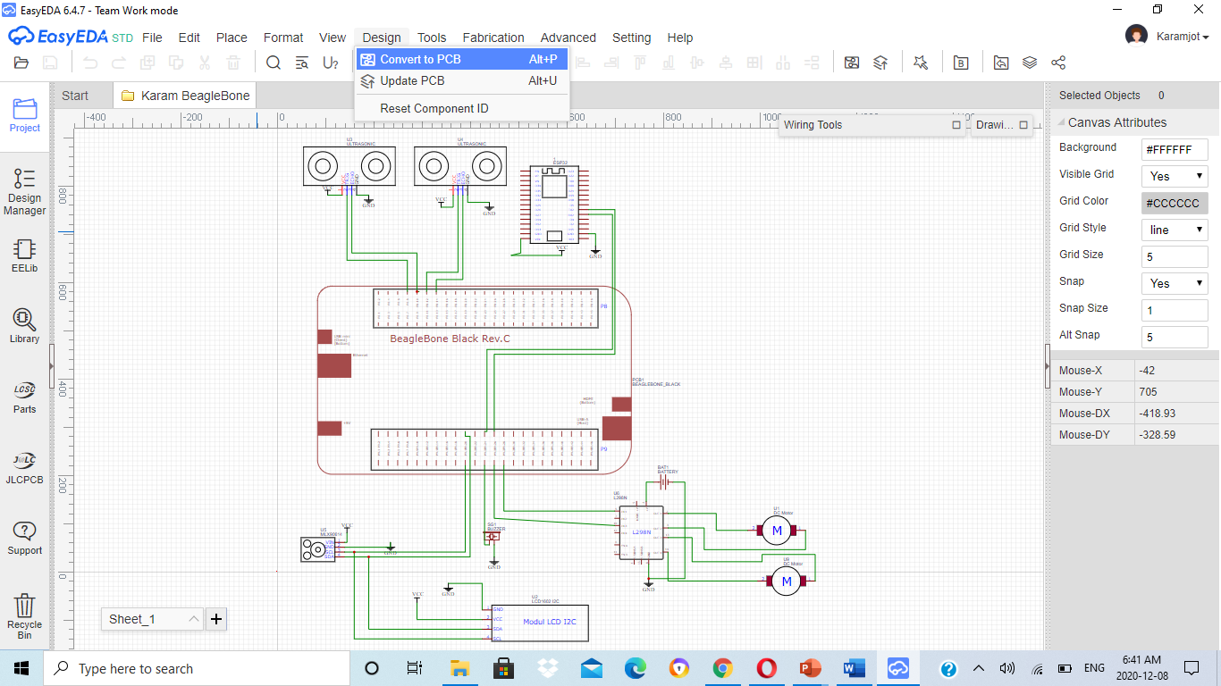
Updated Schematic Diagram

Slide 23
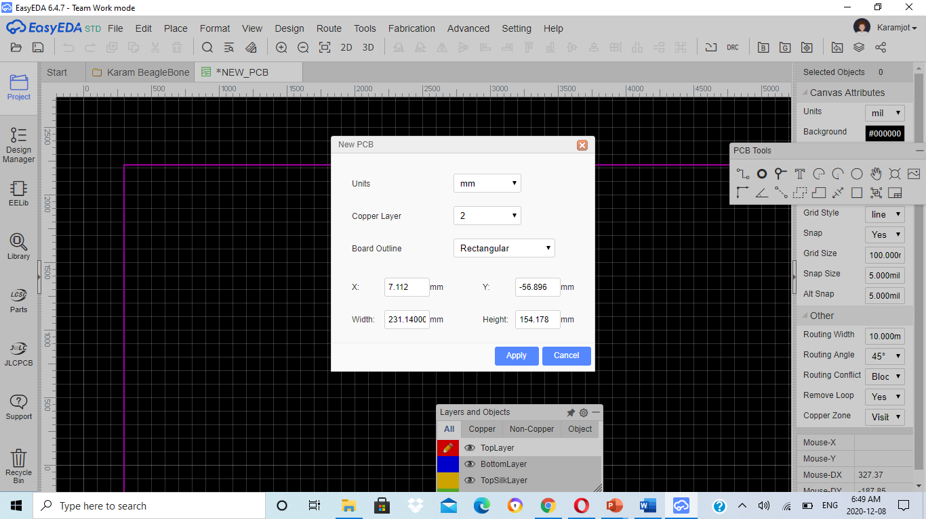
PCB Design Steps

Slide 24
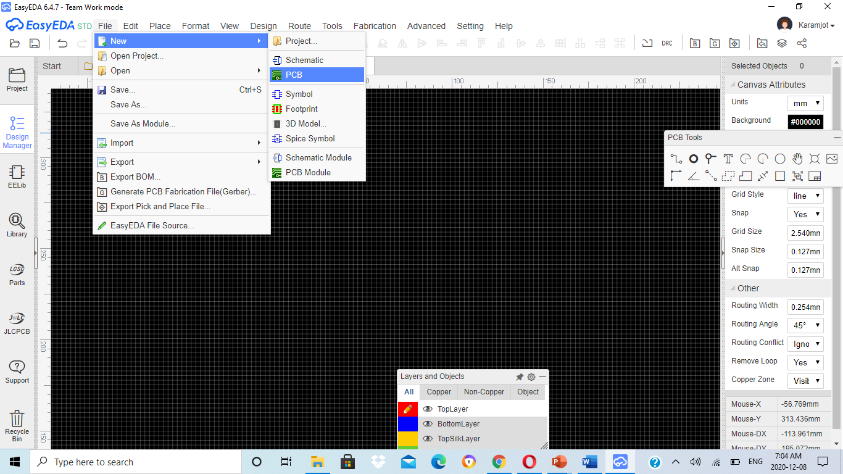
PCB Design Steps
An alternative way to create a PCB in case if we don’t want to use the schematic is to select the components directly the same way we did it for schematic capture.
While selection make sure that the component has some footprint or PCB layout available else we won’t be able to establish the connection.
Once we have all the components ready we can start the connection using the connect pad to pad(o) using PCB tools.

Slide 25
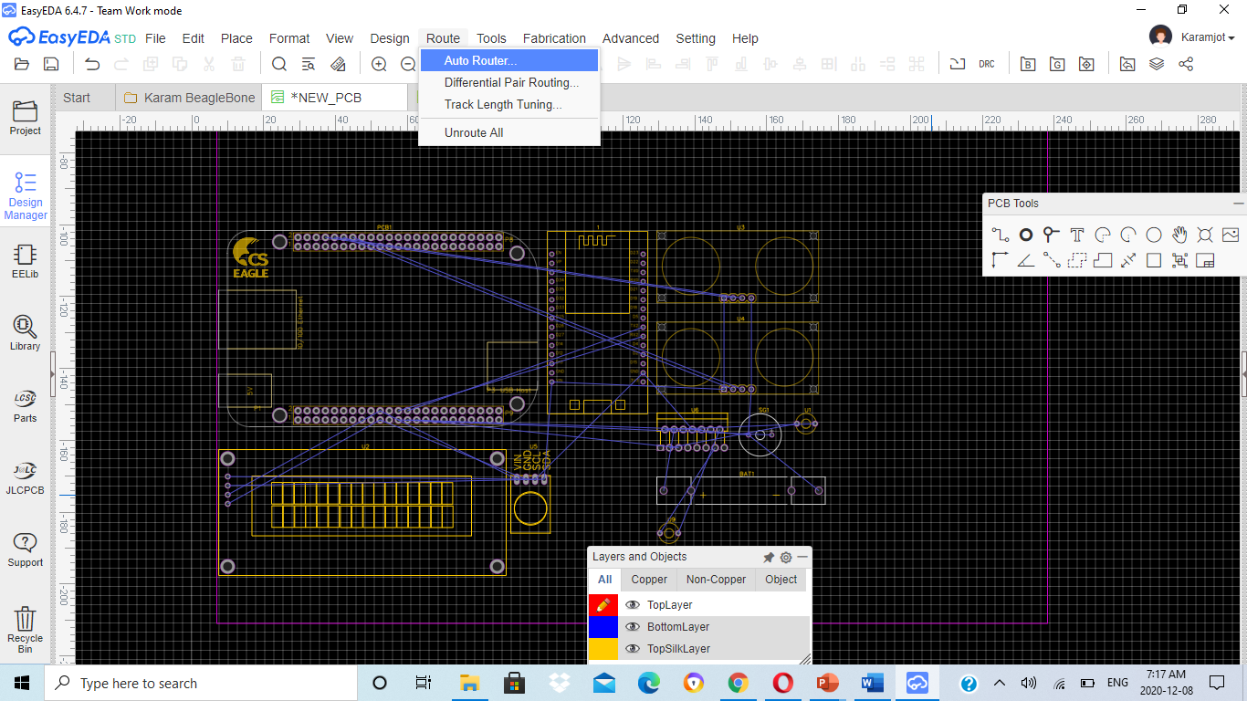
Routing
Once the connection is done the next step is routing so we can use the autoroute option to layout the trace or we can do it manually using the PCB tools.
If the circuit is complex and large then auto routing is preferred else you can go with manual routing in case of simple circuits.
For autorouting select the Auto Route option under the Route menu.

Slide 26
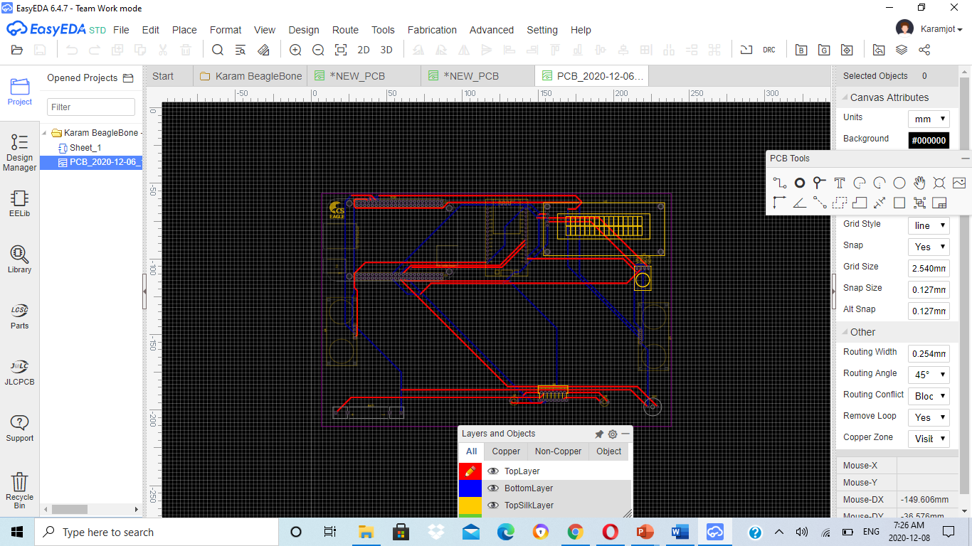
PCB Design Layout

Slide 27
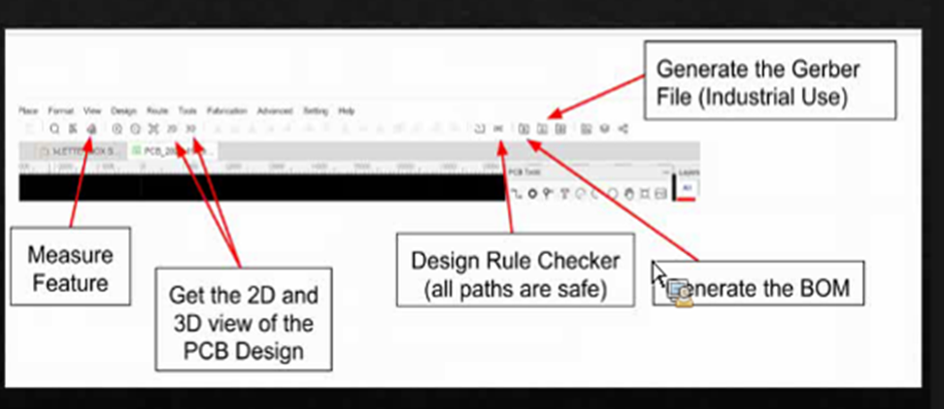
PCB Design
Once we have made proper routing we can generate the desired files which will be used for manufacturing the PCB.
We can generate the Gerber file, Bill of materials, or we can check if the tracks are proper using the Design Rule Check(DRC) ,get the 2D and 3D view of the PCB design.

Slide 28
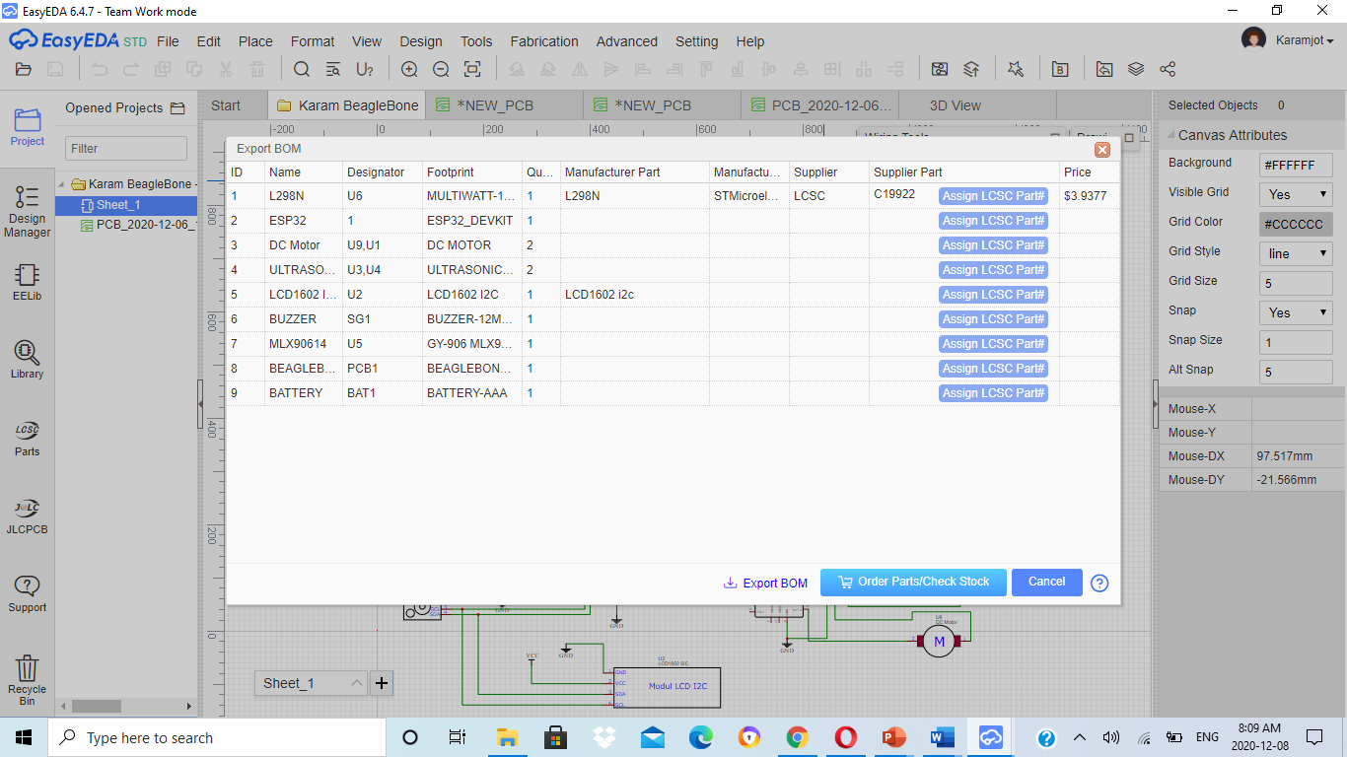
Generating BOM

Slide 29
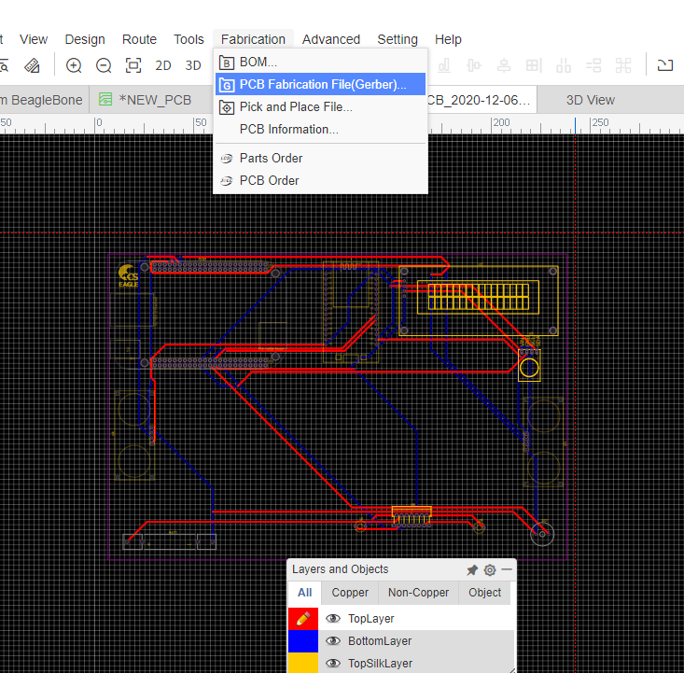
Gerber File
A gerber file is a file format used for PCB manufacturing.
Fabrication machines can use this file to layout electrical connections such as trace and pads. The file also contains information on drilling and milling the completed circuit board.
The standard file extension is .GBR or .gbr though other file extensons are also used.
Under fabrication menu click on gerber file and then you will get an option to export the file so download the file by clicking at that option.

Slide 30
Gerber views
We can generate the gerber files using EasyEda but we cannot view it using the same software as it is no longer supported in this.
We need some third party software to view the gerber file data or we can also use online web based tools and directly drag the file there.
This file helps us to see how the final PCB would like after the manufacturing.
In the next slide we will show the gerber file using the online web based tool known as Online Gerber Viewer by PCBWay.

Slide 31
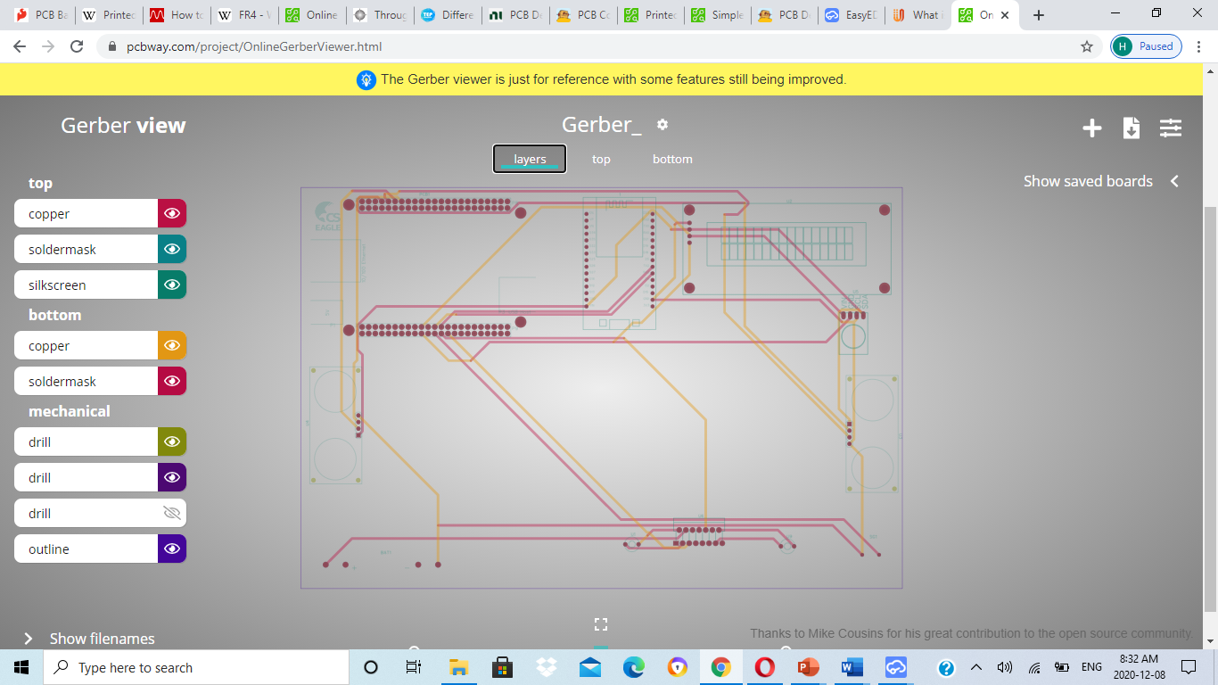
Gerber Views : Layer View

Slide 32
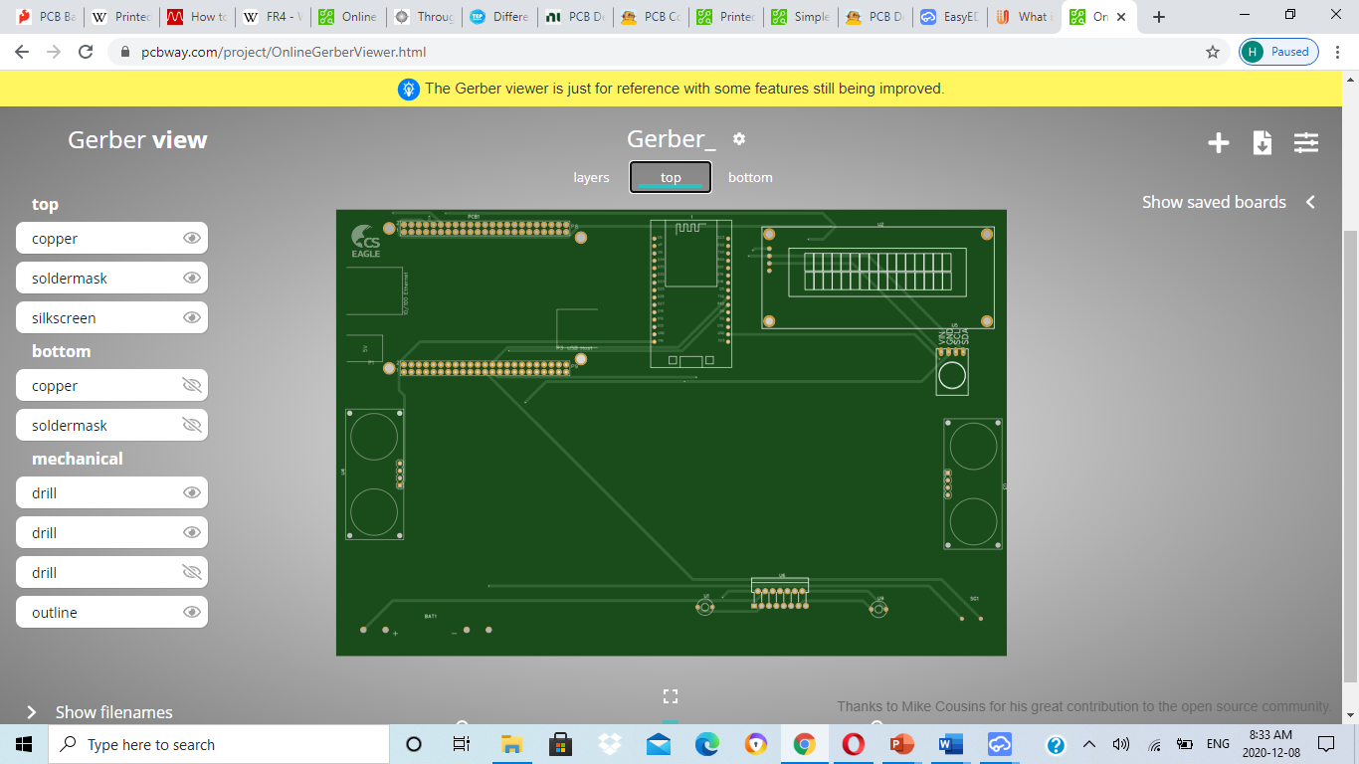
Gerber Views : Top View

Slide 33
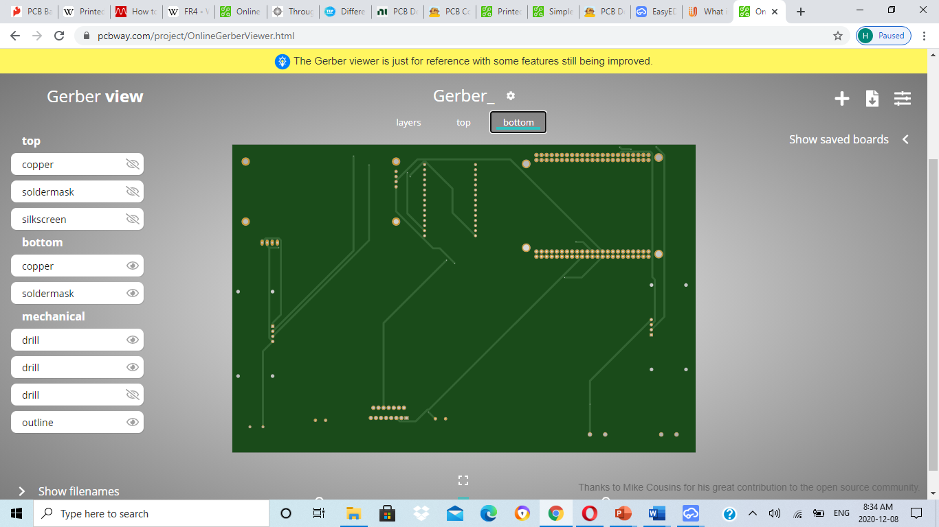
Gerber Views : Bottom View

Slide 34
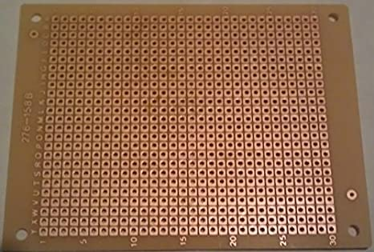
Zero PCB
Zero Printed Circuit Board refers to an all-purpose & conventional PCB that embeds the circuits arbitrarily to ensure the continuous functioning of the hardware.
The layers of general purpose circuit board are coated with copper as to allow appropriate soldering of the components of PCB.
Thus, it reduces the chances of any short circuit.
We tried to contact some of the manufacturers to get our design ready but due to cost constraints and quantity issues and some of them had delivery time issues due to the current circumstances so we couldn’t get the PCB manufactured so we preferred to go with Zero PCB.

Slide 35
Conclusion
This is one of the final task towards the project requirement.
Pcb Designing was successfully discussed in this task.
PCB Design layout was made successfully.
Gerber files were generated and viewed successfully.

Slide 36
References
Aqeel, A. (2018, March 12). Different Types of PCB (Printed Circuit Board). Retrieved from TEP technopreneur: https://www.theengineeringprojects.com/2018/03/different-types-of-pcb-printed-circuit-board.html
How to Design a PCB: printed circuit board layout. (n.d.). Retrieved from electronicsnotes: https://www.electronics-notes.com/articles/analogue_circuits/pcb-design/how-to-design-pcb-board-basics.php
Lin, K. (2014, January 20). Printed Circuit Board Design Flow. Retrieved from PCBWay: https://www.pcbway.com/blog/Engineering_Technical/Printed_Circuit_Board_Design_Flow.html
PCB Tools. (n.d.). Retrieved from EasyEda: https://docs.easyeda.com/en/PCB/PCB-Tools/index.html
randofo. (n.d.). PCB Concepts and Materials. Retrieved from Instructables: https://www.instructables.com/PCB-Concepts-and-Materials/#:~:text=A%20PCB%20consists%20of%20a,need%20to%20concern%20ourselves%20with.
SFUPTOWNMAKER. (n.d.). PCB Basics. Retrieved from Sparkfun: https://learn.sparkfun.com/tutorials/pcb-basics/all
Generate Fabrication File(Gerber).(n.d). Retrieved from EasyEda: https://docs.easyeda.com/en/PCB/Gerber-Generate/index.html

Slide 37

THANK YOU

